Slide 1

Dog-E-DayCare
CSSE 372: SPMP Presentation
TEAM E
ANDREW KOSIKOWSKI
JARED KRAUSS
SAM WALSH
ZHEN YANG

Slide 2
Agenda
Project Management Approach
Estimates
Risks
Schedule of Deliverables
Current Status

Slide 3
Software Project Management Approach
Background:
  Limited Schedule and funds, trying to deliver more features
Agile-Based Incremental Model
  Advantage: Quick, Adaptive, Collaborative
17 Features divided in 5 iteration.
Each Iteration:
  Planning
  Risk Analysis
  Implementation: Analysis, Design, Code, Test
  Customer Eval
  Internal Review

Slide 4
Software Project Estimates
Title | Responsibility | Salary
Database Engineer | Database Architect Developer | $94,021.60
Front-End Developer | User Interface Architect Developer | $74,296.00
Back-End Developer | System Architect Developer | $76,377.60
Software Project Manager | Manage Client Lead System Architect | $77,148.80
Total Monthly Pay |  | $26,820.00
With Overhead |  | $39,425.40
Notes:
For the estimates for the Dog-E-DayCare system, we used a process-based estimate and a parametric estimate, which we derived our final estimate from. To begin our estimates, we pulled historical data on our desired employee types from indeed.com. Need these guys. Factoring in cost of living in Terre Haute, we reduced the positions' salaries slightly. Then, we multiplied them by %147 to account for overhead and benefits, resulting in the $39,000 monthly cost.

Slide 5
Process Based Estimate
Subsystem | Totals
Doggie Security (DS) | 1.49
Doggie Registration & Maintenance Center (DRMC) | 1.11
Vendor Info(VI) | 2.53
Vendor Payment Services Selection(VPSS) | 2.15
Vendor Client Access(VCA) | 3.02
Vendor Peak Search Engine(VPSE) | 2.61
Doggie Billing and Payment Center (DBPC) | 2.39
Doggie Pay (DP) | 3.39
Doggie Track History (DTH) | 2.85
Doggie Action Center (DAC) | 2.81
Doggie Administration Center (DAdminC) | 1.92
Doggie Support Center (DSC) | 0.73
Doggie Research Center (DRC) | 2.10
Doggie Chat (DC) | 1.65
Doggie News (DN) | 3.41
Doggie Vendor Look-See (DVLS) | 3.32
Doggie Breeding Post (DBP) | 1.21
Total | 38.69
Notes:
With this cost per month calculated, we then used our individual experiences in the fields to estimate the effort in person months for each subsystem. We broke each subsystem into activities, such as planing risk analysis, customer evaluation, internal review, and the implementation, which included the analysis, design, coding, and testing. This got us to arrive at an estimated effort of 38.7 person months.

Slide 6
Software Project Estimates
Estimation Type | Effort (person months) | Total Cost
Process-Based | 38.7 | $398,595.62
COCOMO-II (Most Likely) | 44.7 | $457,486.98
Final Estimate Used (Average) | 41.7 | $428,041.30
Project Duration | 5 months
Notes:
Lastly, we then averaged these two estimates as they were fairly close. The process based estimate cost comes to $399,000 when we include salary and $16,000 for various project resources such as hardware and software. Averaging this with the COCOMO-II estimates gave us our final effort estimate of 42.7 person months and a cost of $428,000. With our 4 project members costs, we expect to be able to work on the project for roughly 5 months, with it taking roughly 8-9 months to fully complete all features but going over budget.
For COCOMO-II, we broke down the subsystems into further modules based on their primary languages. This was front-end languages (like html, JS), the primary back-end language of Java, and a database language. We then estimated the SLOC for each of these modules, and arrived at an effort of 44.7 person months and a cost of $457,000.

Slide 7
Software Project Risks – Approach & Key Risks
Several Risks were identified under 7 different categories: Performance, Cost, Support, Schedule, Process, Compliance, and External Risks.
These risks were assessed with a qualitative risk analysis of the risks’ impact and probability. High risk values indicated more these key risks:
1. Capabilities & Features
2. Training Costs
3. Limited Budget
4. Project Process Delays
5. Underdeveloped or New Requirements and Features
These risks were reviewed to ensure proper monitoring and control of these items with mitigation and contingency plans.

Slide 8
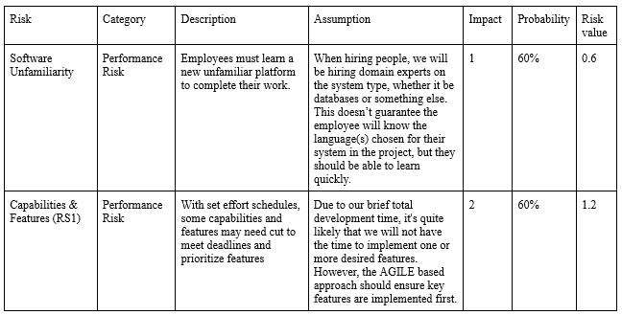
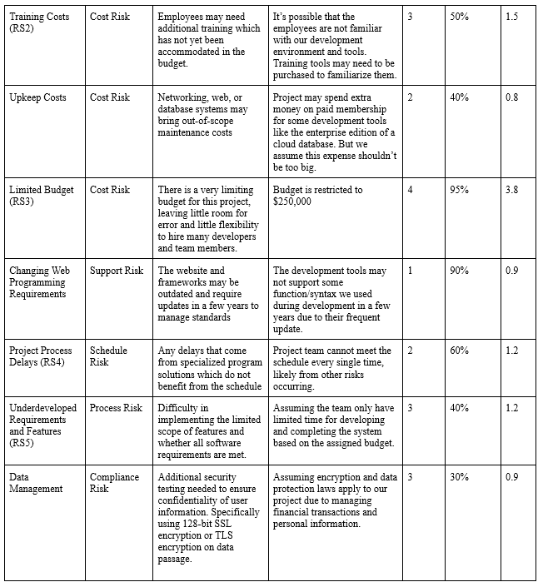

Software Project Risks – Approach & Key Risks

Slide 9
Software Project Risks –
High-Risk Items (1)
Risk Item 5, Limited Budget was the third high-risk item assessed for mitigation.
This risk was deemed catastrophic with a risk value of 3.8/4.0, as loss of resources would completely halt the project and force delivery of a potentially incomplete product.
Triggers for the effects of this limited budget stem from the significant number of tasks identified with the project’s low budget of $250,000.
If the schedule is delayed significantly, the existing risk contingency fund has been expended, or additional features are brought forward during the project schedule, this risk pushes the project towards failure.
Mitigation by (a) monitoring our risks closely, (b) monitoring the budget impact, and (c) increased communication with the client to ensure additional requirements are limited or more easily managed.

Slide 10
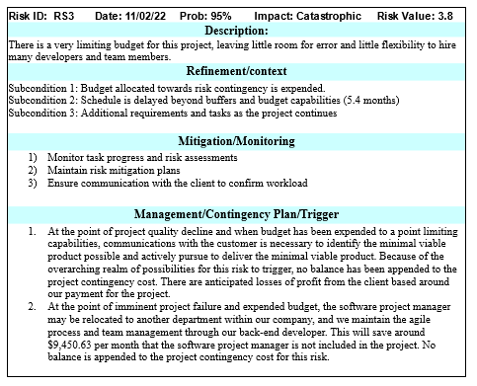
Software Project Risks –
High-Risk Items (1)

Slide 11
Software Project Risks –
High-Risk Items (2)
Risk Item 3, Training Costs was another high-risk item assessed for mitigation.
This risk was deemed critical with a risk value of 1.5/4.0, as the potential for budget usage to train the employees on unfamiliar programs or processes risks schedule delays.
Triggers for the effects of this risk stem from inexperience within the employees since we are hiring at relatively low pay and likely recruiting employees with less experience.
The Software Project Manager will need to invest time and resources to allow these employees to train and gain confidence in the software necessary for the project.
Mitigation through a thorough onboarding process of new employees as well as an early meeting to identify experience weaknesses.

Slide 12
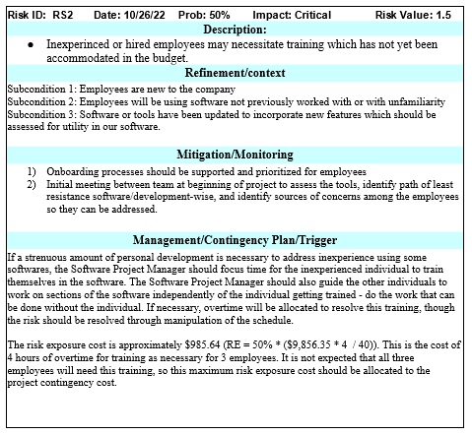
Software Project Risks –
High-Risk Items (2)

Slide 13
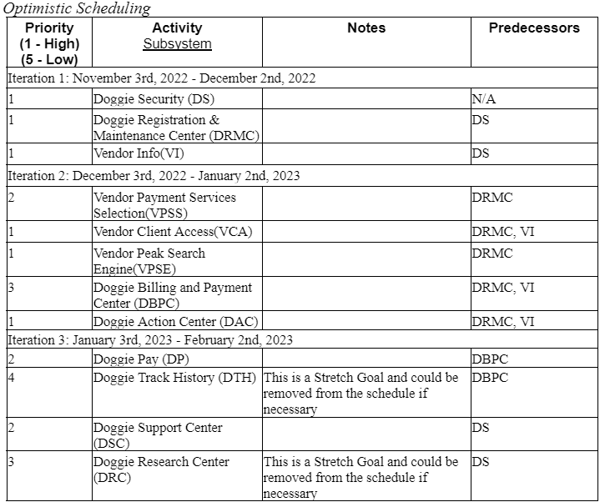
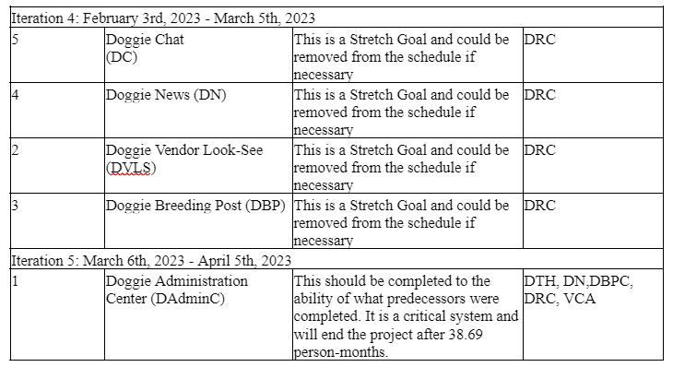
Optimistic Project Schedule of Deliverables

Slide 14
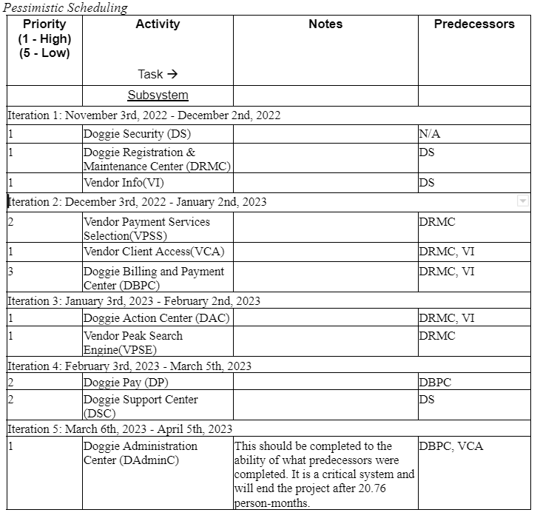
Pessimistic Project Schedule of Deliverables

Slide 15
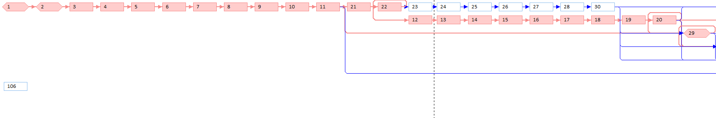
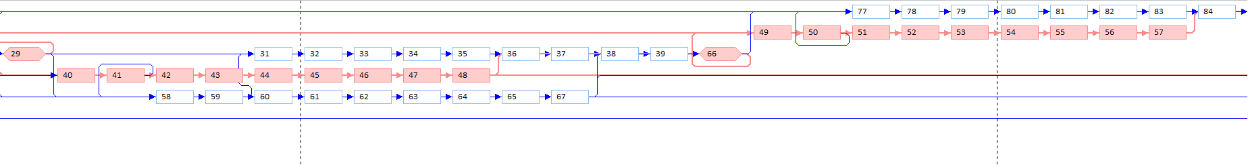
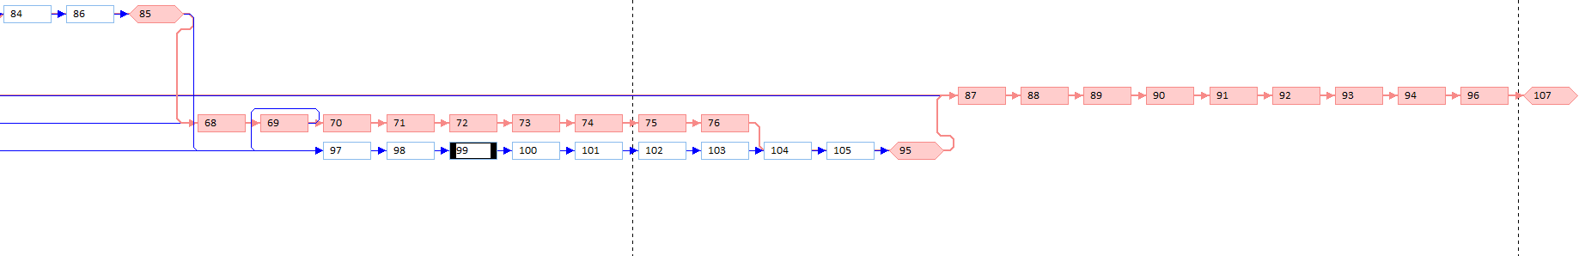
Critical Path

Slide 16
Software Project Status
Assumption:
  Schedule Status: 2 of 5 months passed
  Funding status: $115000 of $250000 budget is spent.
  Work Completion status: 33% of Total workload finished. (scheduled for 42%)
Status Calculation:
  Planned Value : 42% * 250000 = 105000
  Actual Cost: 115000
  Cost Performance Index: EV/AC = 0.717(over budget)
  Schedule Performance Index: EV/PV = 0.786 (behind schedule)
  Cost Variance = EV-AC = -32500
  Estimate to Complete = [(BAC - EV) / CPI] = 233612.27 (17.8weeks left)
  Estimate at Completion = AC + ETC = 348612.27(25.8 weeks 3.3 weeks behind schedule)

